Slide 1
Protected Loss Fund Program Seminar

Slide 2
Agenda
Protected Loss Fund Program (PLFP)
Purpose
Programs
Structure & Costs
Claims Review
Break
Identifying Risks
Lessons from the field
Lunch
Emerging Issues
Special Events
Break
Online Resources

Slide 3
Insurance & Claims Services Who we are
Vince Andrews, Manager – 27 years
Russ Owen, Loss Prevention Representative – 26 years
Karen Halas, Risk Management Coordinator – 23 years
John Greenburg, Risk Control Specialist – 12 years
Rosemary Gleason, Loss Prevention Representative – 8 years
Notes:
96 combined years of experience!

Slide 4
Protected Loss Fund Program (PLFP) Purpose
Resource for Loss Prevention
Placement of Excess Insurance to protect (Arch)Diocesan activities
Insurance and Claims Assistance and Management

Slide 5
Protected Loss Fund Program (PLFP) Service Programs
PLFP
Clergy Auto
Special Events
Priest Personal Protection Program
Student Accident
Travel Insurance
Loss Prevention Services and Education
Appraisal Services
Certificates of Insurance

Slide 6
Service Programs PLFP
Comprehensive Property Insurance
General Liability (GL)
Workers Compensation (WC)
Parish-owned autos

Slide 7
PLFP Comprehensive Property Insurance
All Risk Property and Content Coverage for sudden and accidental losses
Crime/Fidelity Coverage
Boiler and Machinery
Coverages are determined under the excess insurance policy language

Slide 8
PLFP General Liability
Slip, Trip and Fall
Directors & Officers
School Board Legal Liability
Counselor’s Errors & Omissions
Parish Nurse protection
Cyber Liability
Pollution Legal Liability

Slide 9
PLFP Workers’ Compensation
Injuries occurring in or out of course of an employees’ duties
Who’s covered
What’s covered
Notes:
Light Duty

Slide 10
PLFP Diocesan/Parish Owned Vehicles
Subject to the Michigan No-Fault Statute
Priority of Benefits
Title Requirements
Notes:
Level of benefits

Slide 11
Service Programs Clergy Auto
Priest-owned vehicles
Separate program from PLFP vehicle coverage
Separate line item on parish invoice
First party coverage/vehicle damage
$250 deductible broad form collision
$100 Comprehensive deductible
$0 Glass damage/free replacement
$45/day rental reimbursement
$50 limit of towing/road service
Liability limit of $1,000,000 – new as of July 1, 2016

Slide 12
Service Programs Special Events
Summary of Coverage
$1,000,000 – new as of July 1, 2016
1 calendar date
Parish Control
Form completion and submitting
Payments
Examples this afternoon

Slide 13
Service Programs Priest Personal Protection Program
Liability limit of $1,000,000
Examples of policy triggers
Dog bites
Errant golf balls
Personal Libel and Slander

Slide 14
Service Programs Student Accident
Student Assurance Services (SAS)
Coverage for all school/religious education/sports children’s activities resulting in injury
Subject to the SAS policy limits
Excess of any health plans applicable to the child
Additional coverage for full time available through SAS for purchase
Information, coverage language and claims forms are available on SAS website: www.sas-mn.com

Slide 15
Service Programs Travel Accident
Travel Accident FAQs
Notes:
REMIND to take policy summary sheet with you on a trip.

Slide 16
Service Programs Loss Prevention and Education
Comprehensive loss prevention assessments
Online resources
Learning Management System
MCC/RM forms & documentation
Travelers’ risk control
GB Risk Control
MCC telephone support

Slide 17
Service Programs Appraisal Services
Annual construction cost indices
New construction, acquisitions and major renovations
As needed

Slide 18
Service Programs Certificates of Insurance (COIs)
On-demand service to provide COIs to 3rd party for diocesan activities and leased property
Proper notification needed when leased property is updated (i.e. new copier)

Slide 19
PLFP Structure
Liability |  |  |  | Property |  |  | Boiler and Machinery |  |  | Crime | Workers' Compensation | Pollution Legal Liability | Cyber Liability
$100,000,000 |  |  |  | $210,000,000 |  |  | $100,000,000 |  |  | $5,000,000 | Statutory Coverage | $10,000,000/ | $10,000,000
Torus |  |  |  | Travelers |  |  | Hartford Steam |  |  | PESLIC | Safety National | $25,000,000 | Chubb/ACE
$14,000,000 xs $86,000,000 |  |  |  | $ 200,000,000 xs $10,000,000 |  |  | Boiler Inspection |  |  |  | Coverage A | Aggregate
 |  |  |  |  |  |  | & Insurance Co. |  |  |  |  | Ironshore
 |  |  |  |  |  |  |  |  |  |  |  | Specialty
 |  |  |  |  |  |  |  |  |  |  |  | Ins. Co.
$86,000,000
Allied World
$25,000,000 xs $61,000,000
$61,000,000
Ironshore
$25,000,000 xs $36,000,000
$36,000,000 |  |  |  |  |  |  |  |  |  |  | Coverage B
Lexington |  |  |  |  |  |  |  |  |  |  | Employers Liability
$25,000,000 xs $11,000,000 |  |  |  |  |  |  |  |  |  |  | $400,000 xs SIR
$11,000,000 |  |  |  | $10,000,000
PESLIC |  |  |  | PESLIC
$10,000,000 xs $1,000,000 SIR |  |  |  | xs $1,000,000 SIR
 |  |  |  |  |  |  |  |  |  | xs
 |  |  |  |  |  |  |  |  |  | $350,000 SIR
PROVINCIAL LAKE SPC
Liability |  |  |  | Property |  |  | Boiler and Machinery |  |  | Crime | Workers' Compensation | Pollution | Cyber Liability
$1,000,000 SIR |  |  |  | $1,000,000 SIR |  |  | $5,000 SIR |  |  | $350,000SIR | $1,000,000 SIR | Legal Liability | $50,000 SIR
 |  |  |  |  |  |  | $10,000 SIR |  |  |  |  | $50,000 SIR
 |  |  |  |  |  |  | Freeze and Lightning

Slide 20
PLFP Structure (cont’d) Vendor Relationships
Arthur J. Gallagher
Gallagher Bassett Services, Inc.
Excess Underwriters
Munich
Travelers
Safety Nation
Etc.

Slide 21
PLFP Structure (cont’d) (Arch)Diocesan Costs
Actuarial Review
Exposures
Building Values
Wages
Autos
Above determines self-insured retention levels
Excess insurance
Includes above exposures
Student and Athlete counts
More specific details on all aspects of (Arch)Diocesan activities and assets
Both the Actuarial and Excess underwriters reviews are heavily weighted by Loss History

Slide 22
Clams Review and Discussion
Last five years (7/1/2011 – 6/30/2016)
Province Wide
“Top 10” in each category
Review Frequency and Severity by:
Coverage
Source
Nature
Preventable vs Non-preventable

Slide 23
Claims Review and Discussion By Coverage Frequency
Notes:
RB=All Risk Buildings
AP=Auto Physical Damage
WC=Workers Compensation
GB=General Liability
RC=All Risk Contents
AD=Auto Liability Property Damage
EP=Employment Practices Liability
GD=General Liability Property Damage
CM=Crime Money & Securities
PI=Personal Injury

Slide 24
Claims Review and Discussion By Coverage Severity
Notes:
FF=Fidelity and Forgery
AB=Auto Liability Bodily Injury
AN=Auto No Fault

Slide 25
Claims Review and Discussion By Source Frequency
Notes:
This one is actually alphabetical

Slide 26
Claims Review and Discussion By Source Severity

Slide 27
Claims Review and Discussion By Nature of Loss Frequency

Slide 28
Claims Review and Discussion By Nature of Loss Severity

Slide 29
Claims Review and Discussion Preventable vs Non-Preventable
5-year Claim total
5,723 claims
$40,781,797 total incurred
Claims identified as preventable
774 claims
$3,751,059 total incurred or
Almost 10%

Slide 30
Claims Review and Discussion How and When to submit a claim
How:
Gallagher Bassett Services
866-850-1933 for Property, GL, CA and PLF Autos
800-926-1819 for WC
When:
Within 24 hours of an incident
Claim vs Incident
Significance of early reporting

Slide 31
Claims Review and Discussion Report Lag
Notes:
Threshold is 1-5 days, Above Threshold = >5 days.

Slide 32
BREAK

Slide 33
Identifying Risks
Must be able to identify risks that exist around you
Each member of the staff should contribute to the overall loss prevention
Common everyday risks abound
Notes:
If you have leased premises it is still your duty to maintain reasonable control over your property. Make sure you conduct periodic inspections to make sure the lessee is complying with the minimum safety and security standards.

Slide 34
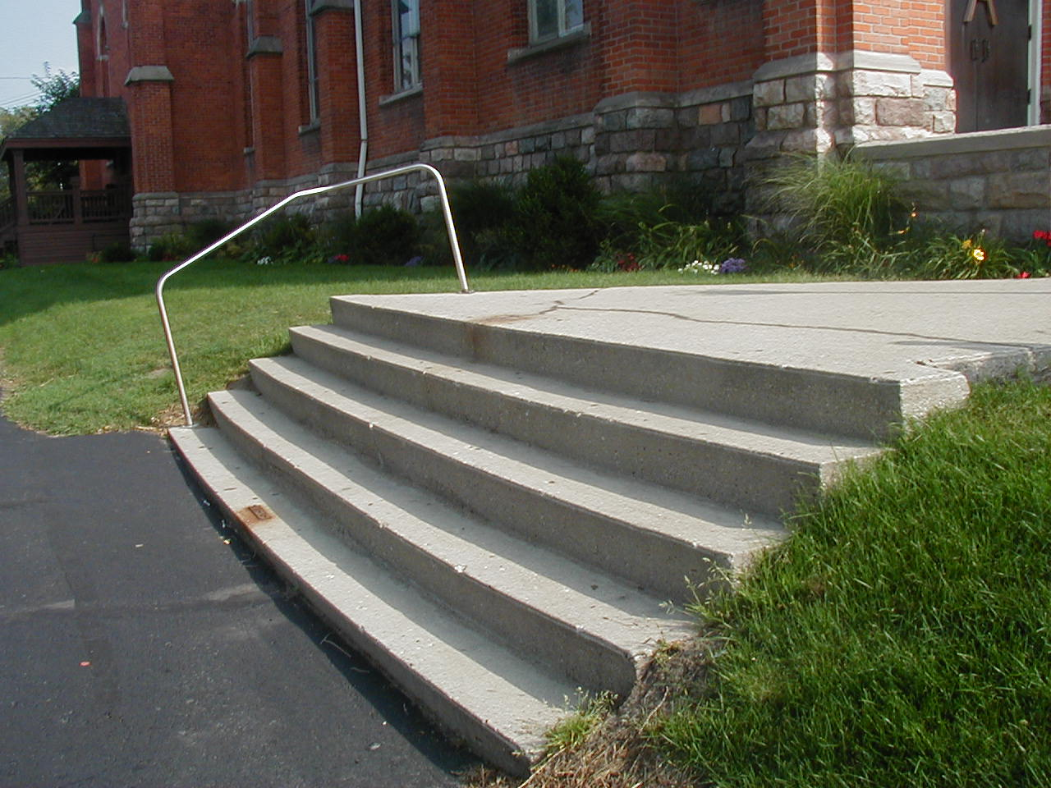

Slide 35
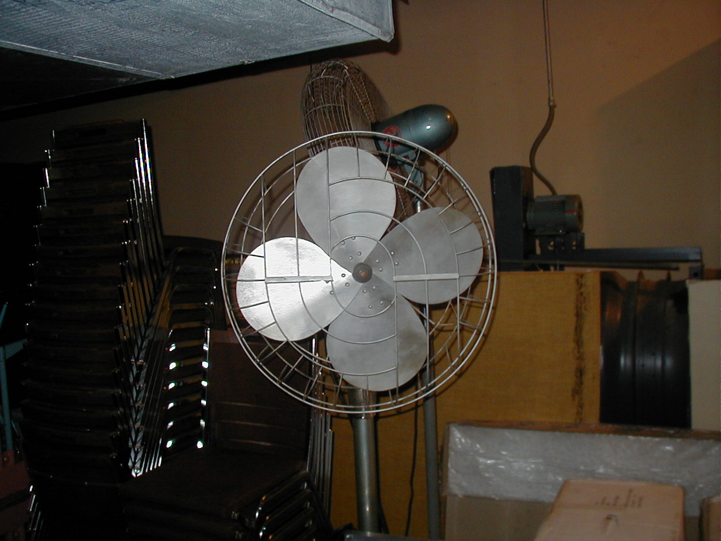

Slide 36
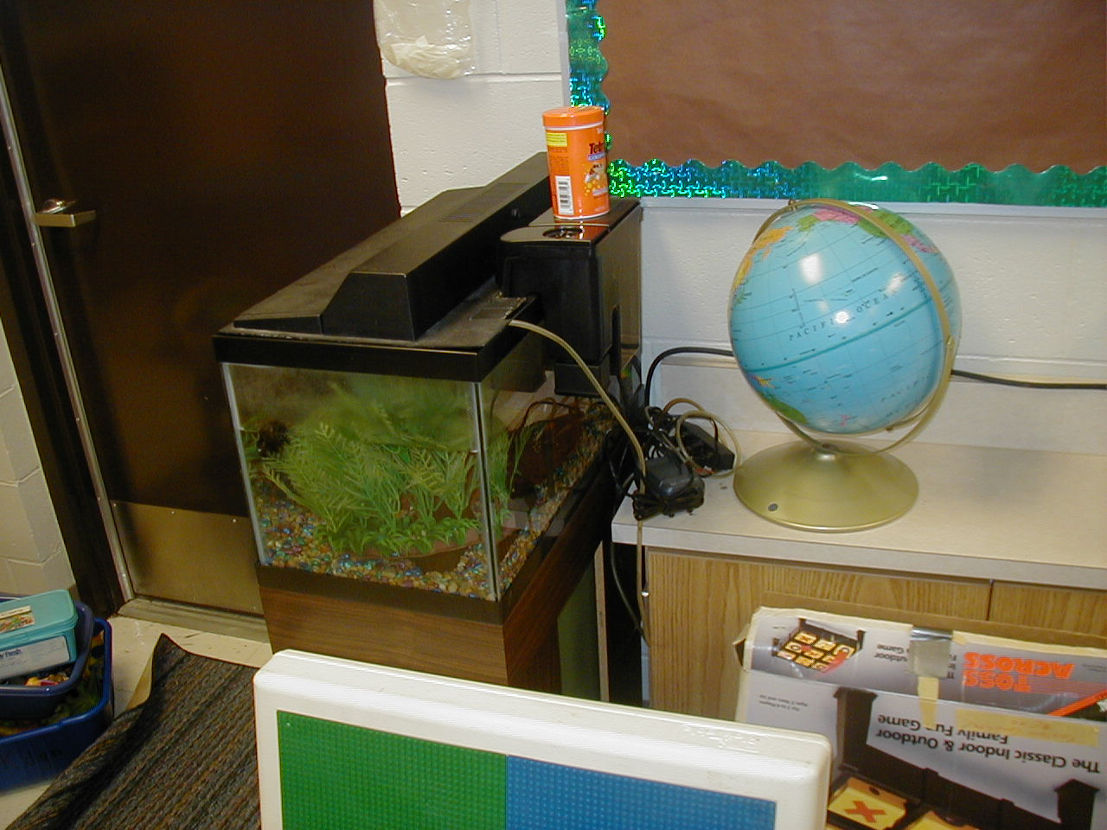

Slide 37
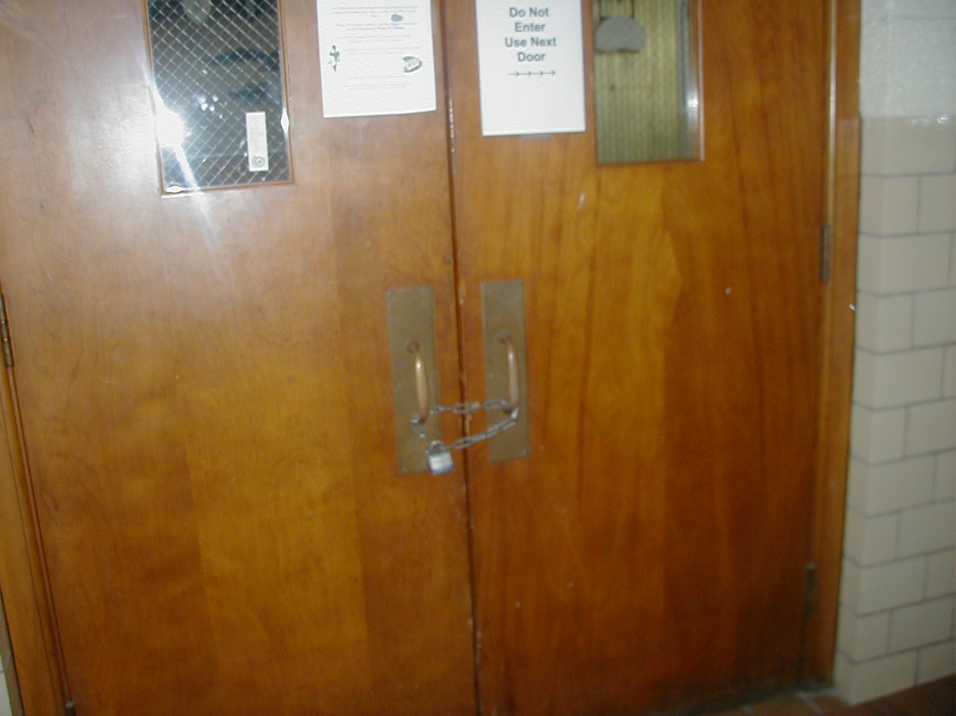
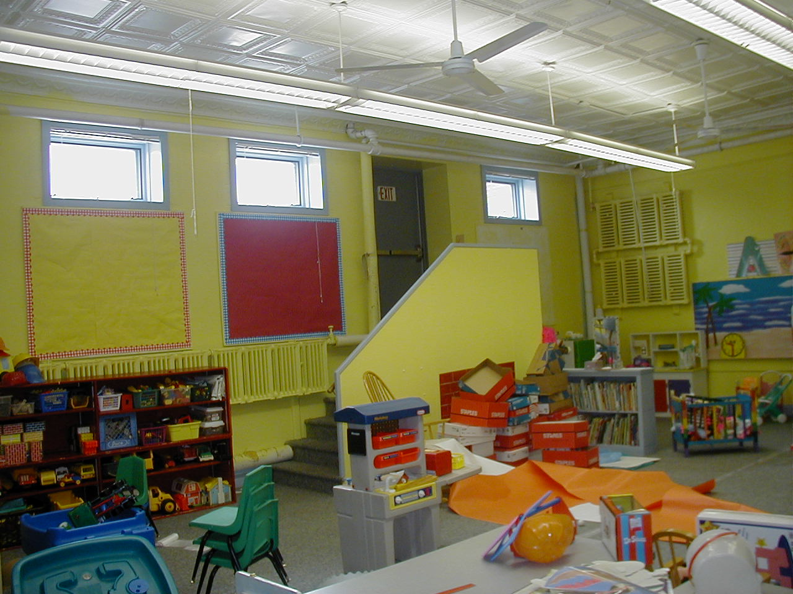

Slide 39
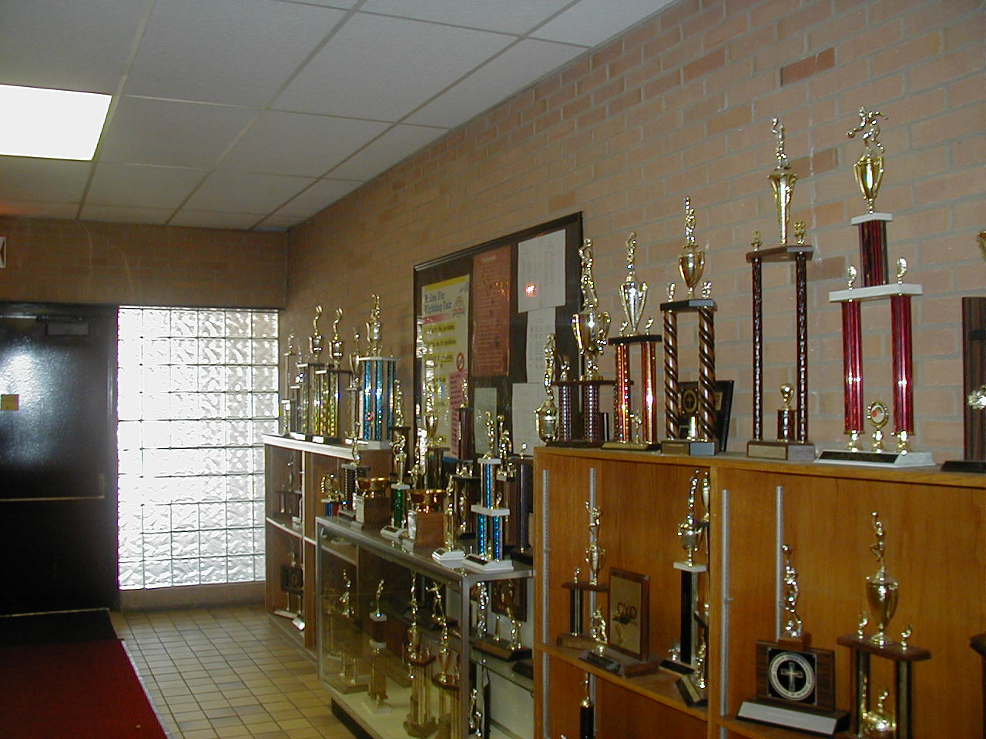

Slide 40
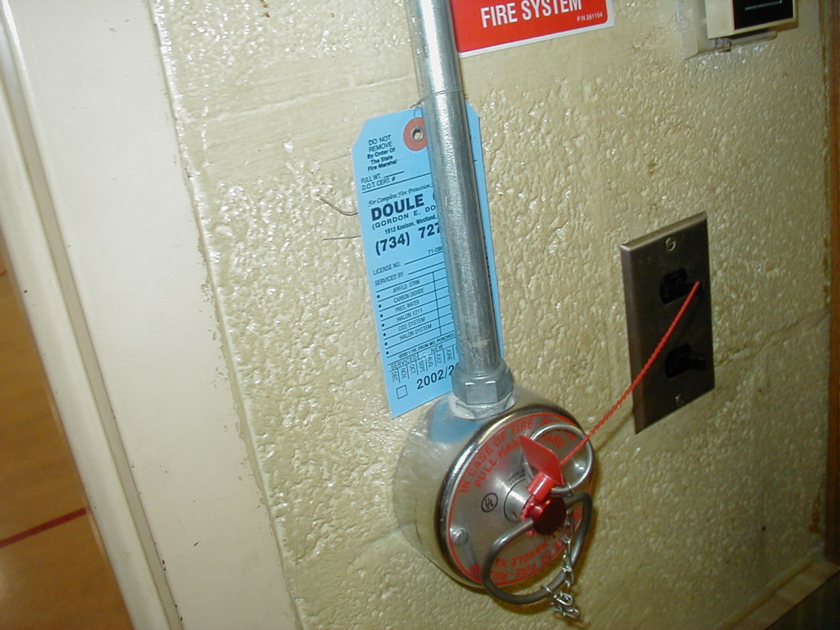
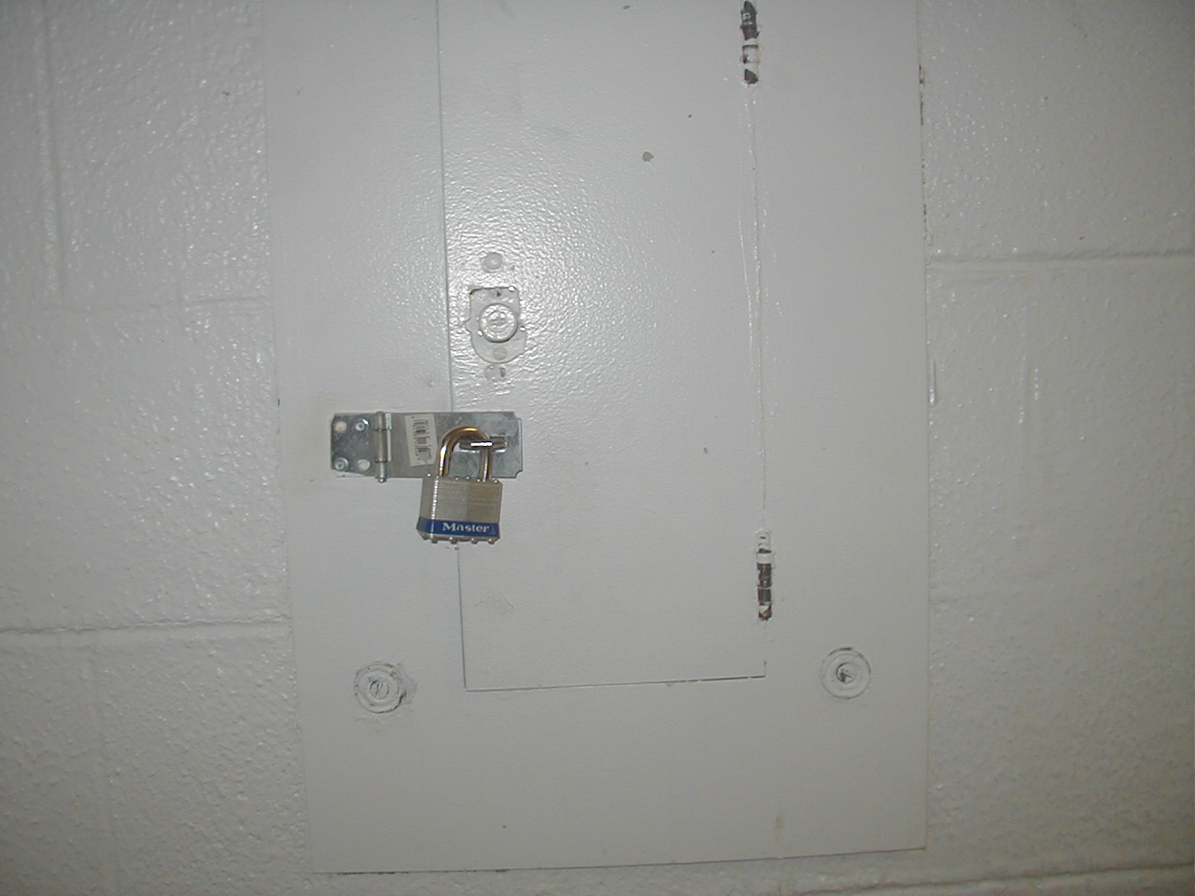

Slide 41
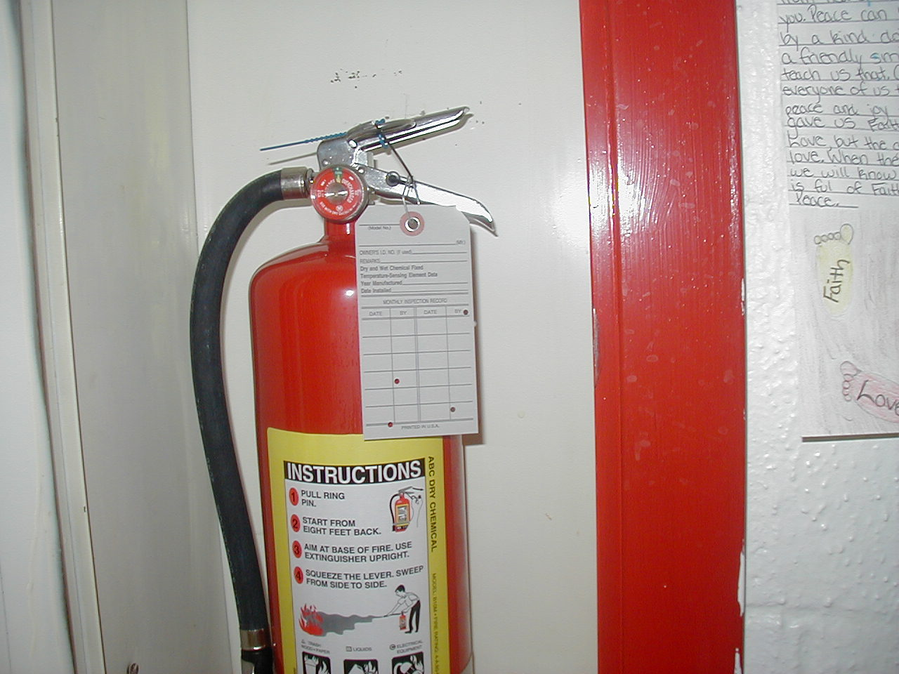

Slide 42
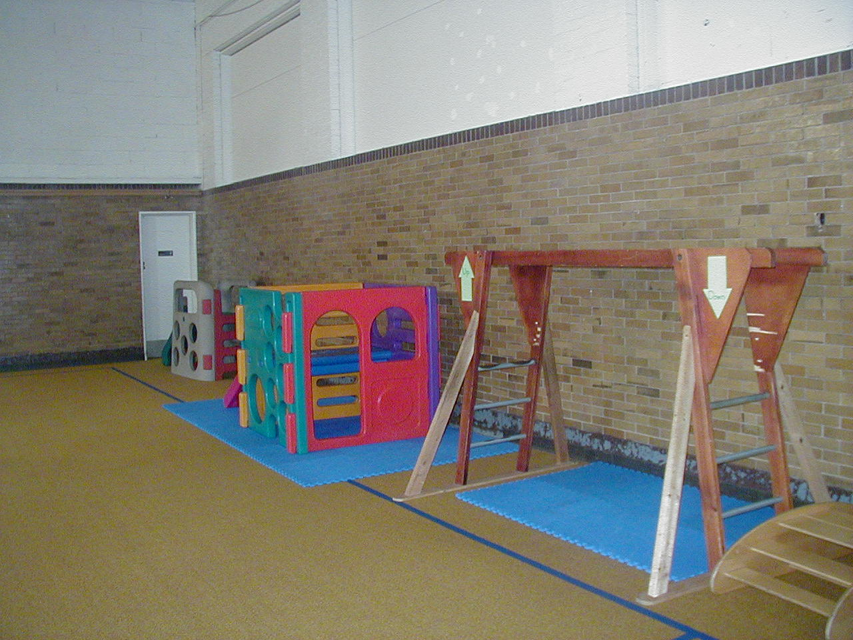

Slide 43
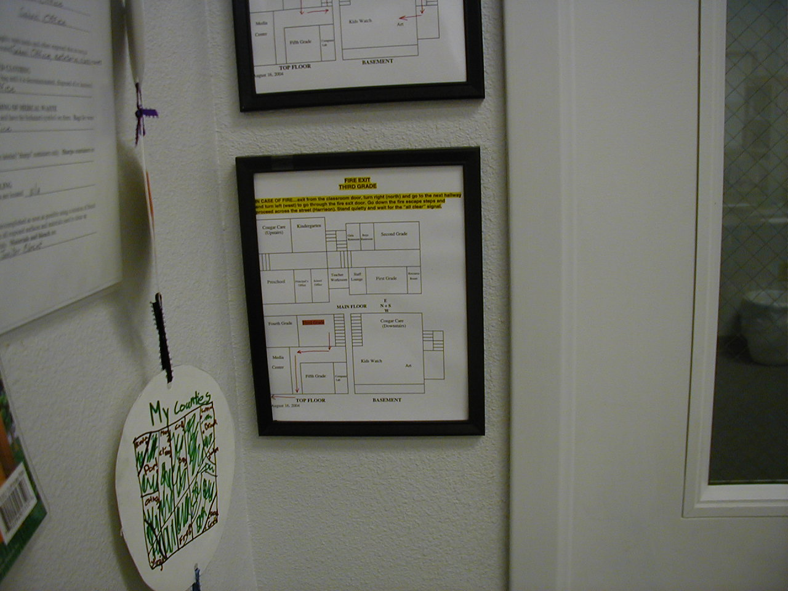

Slide 44
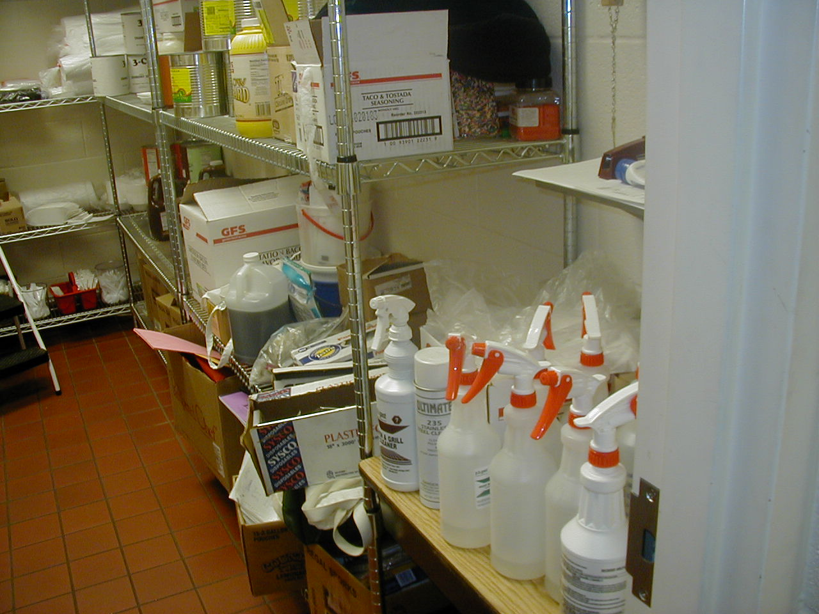

Slide 45
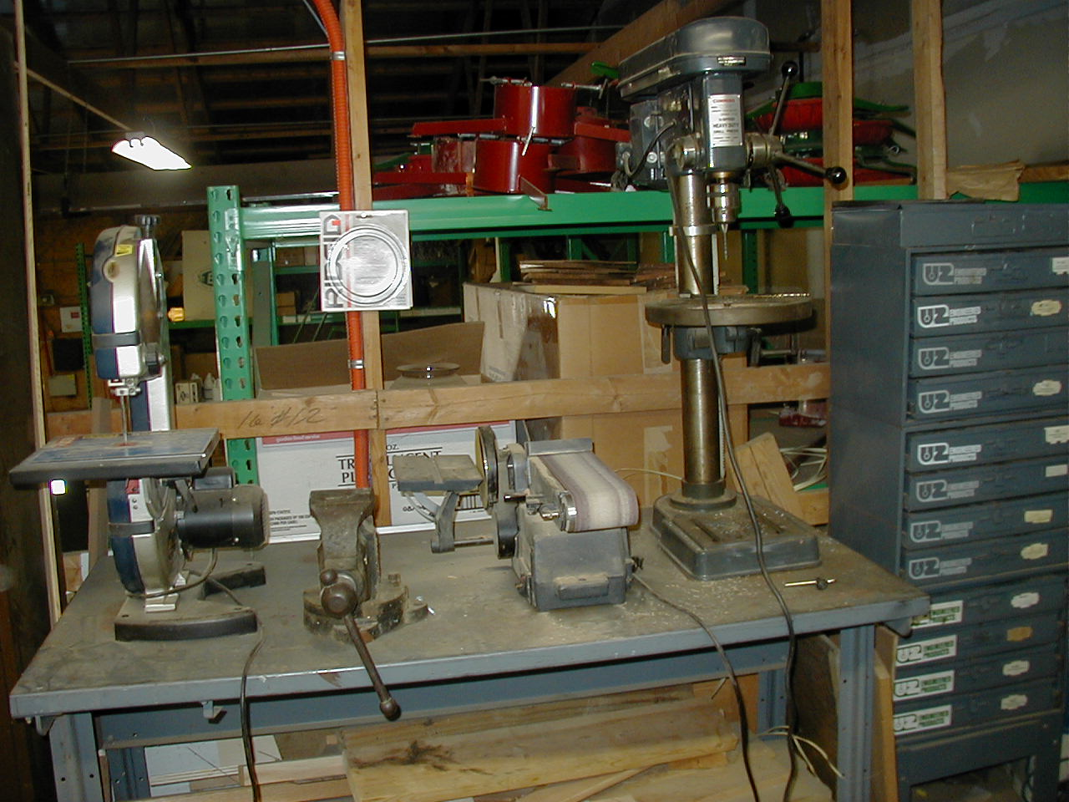

Slide 46
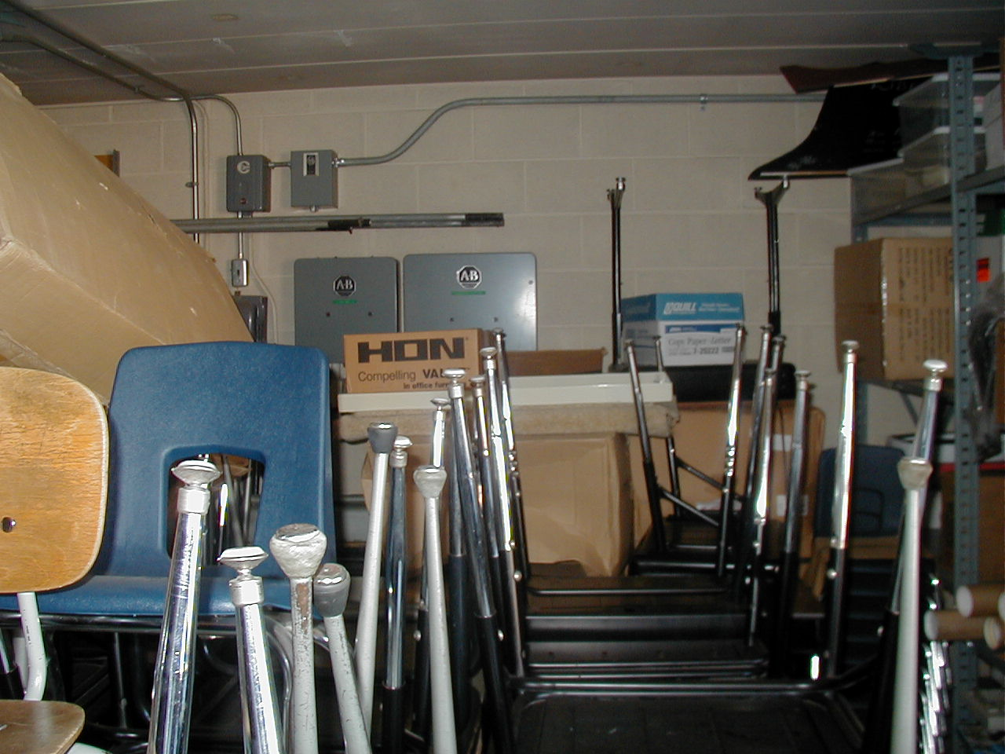

Slide 47
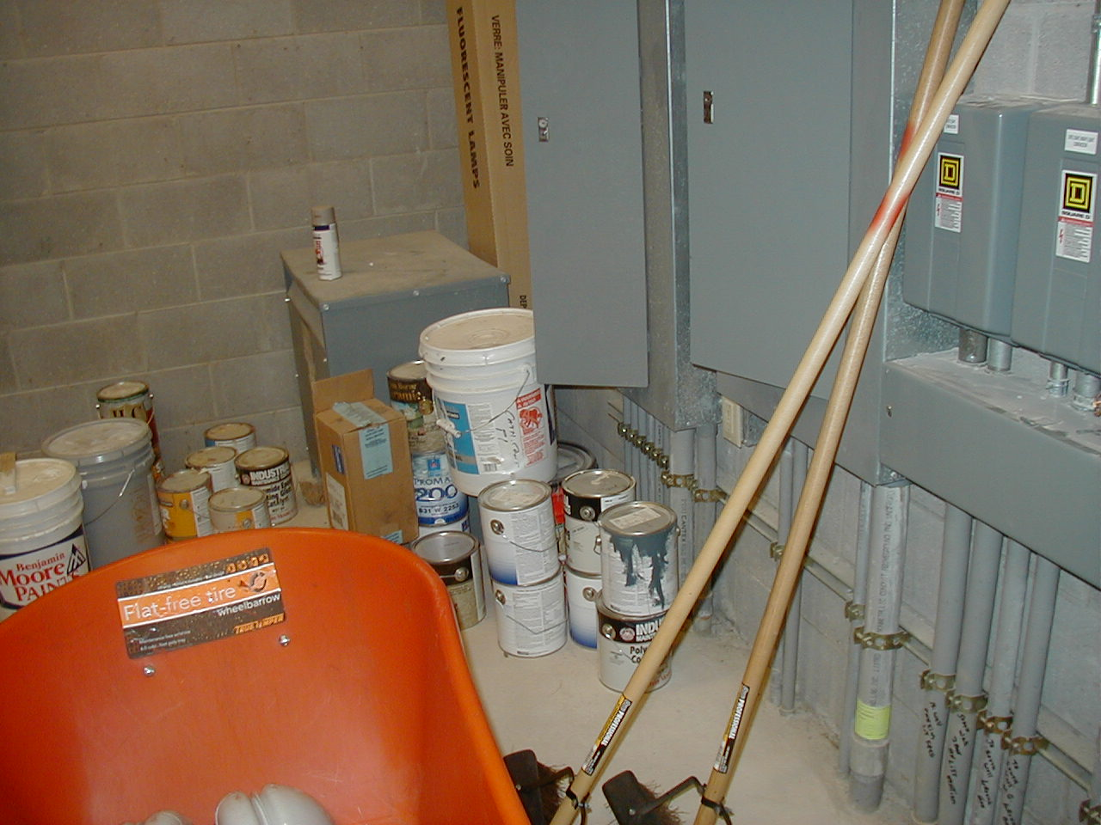

Slide 48
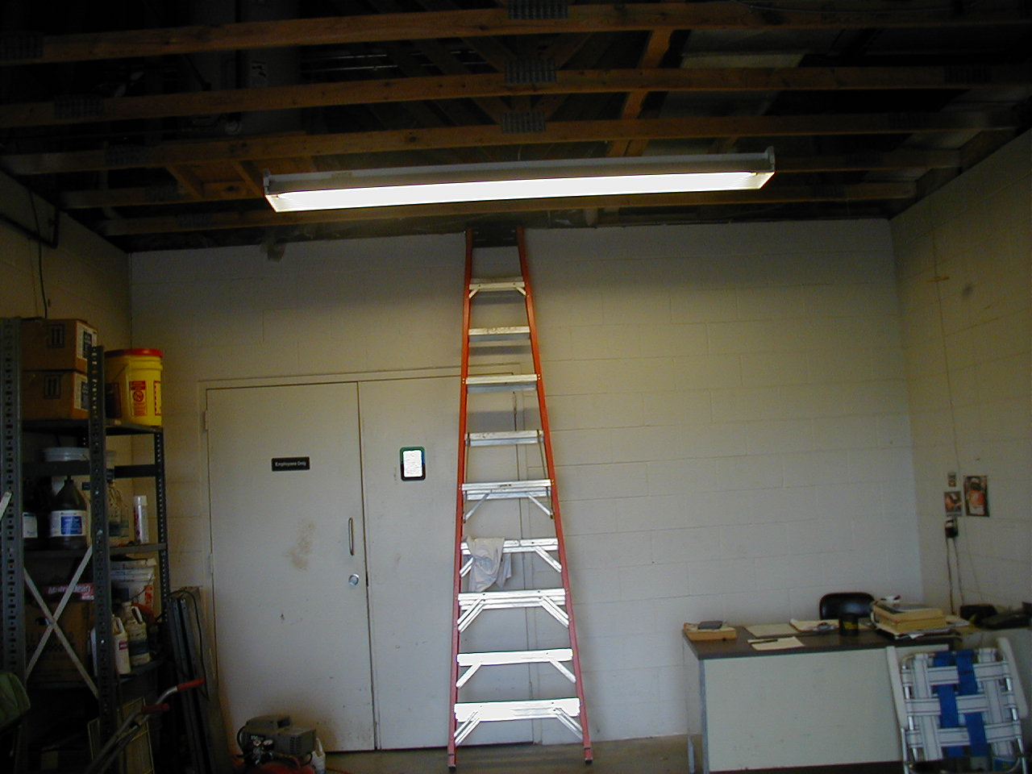

Slide 49
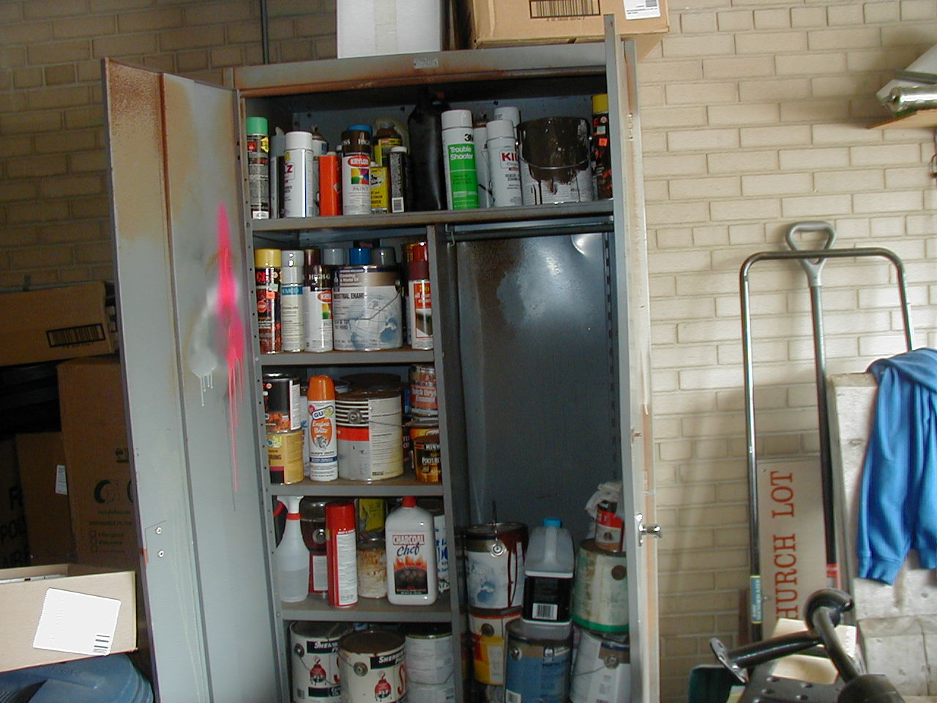

Slide 50
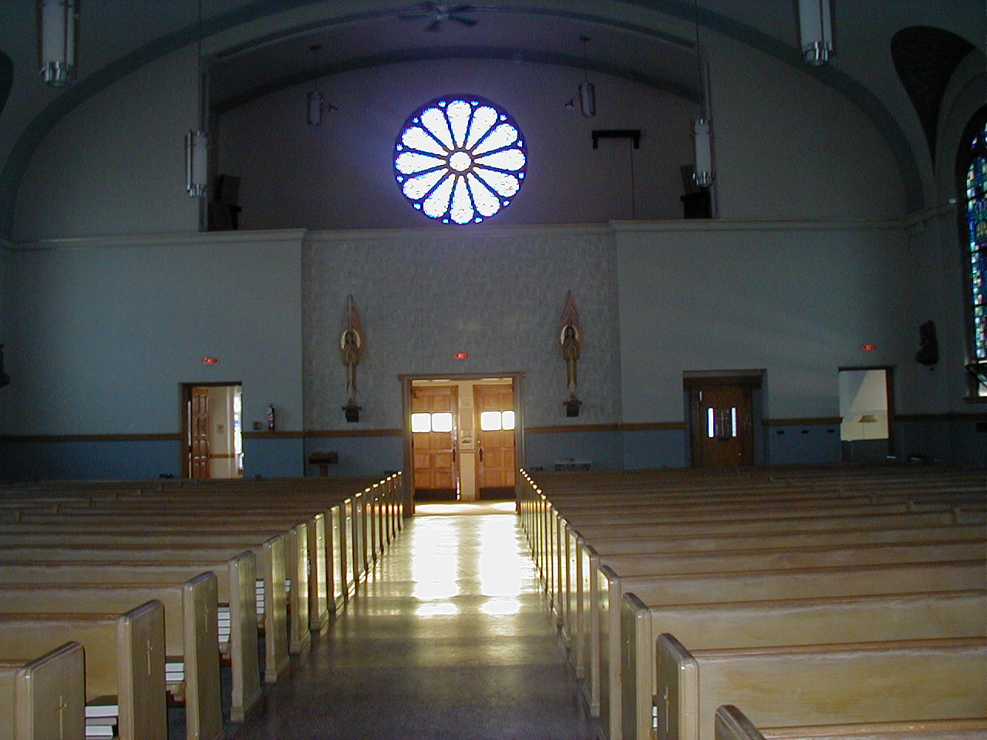

Slide 51
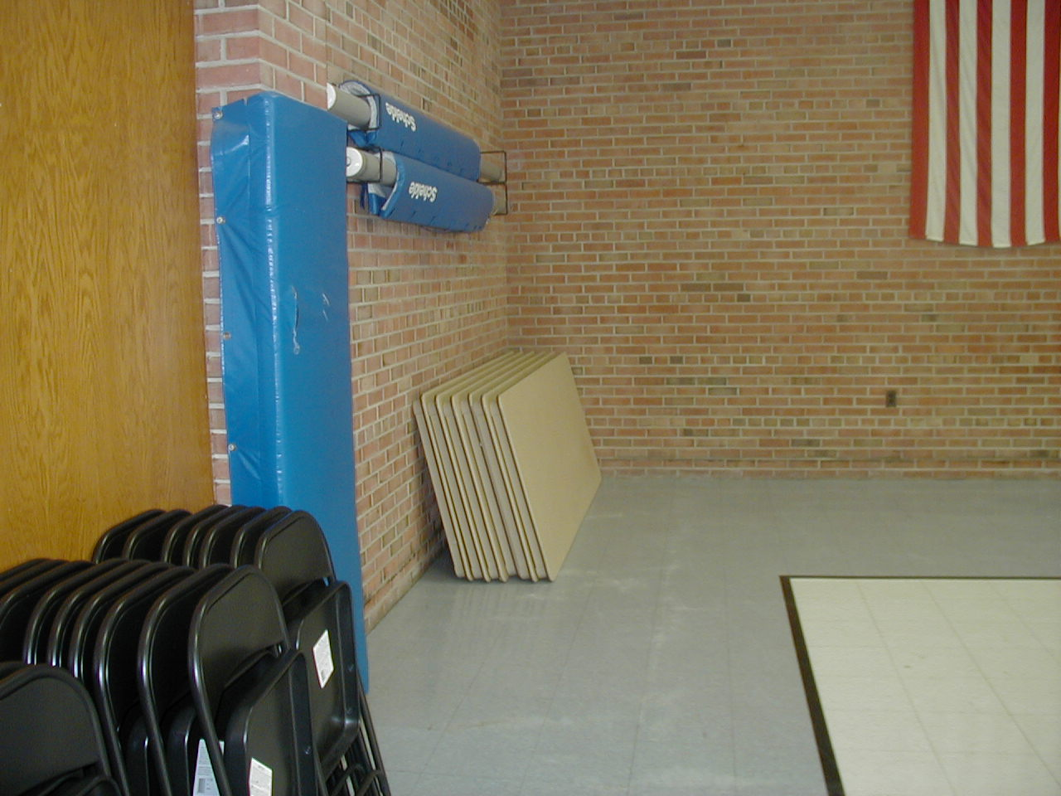
Notes:
Make sure you check the old-style tables that are stored recessed in the wall. A recent terrible loss occurred relating to these tables.

Slide 52
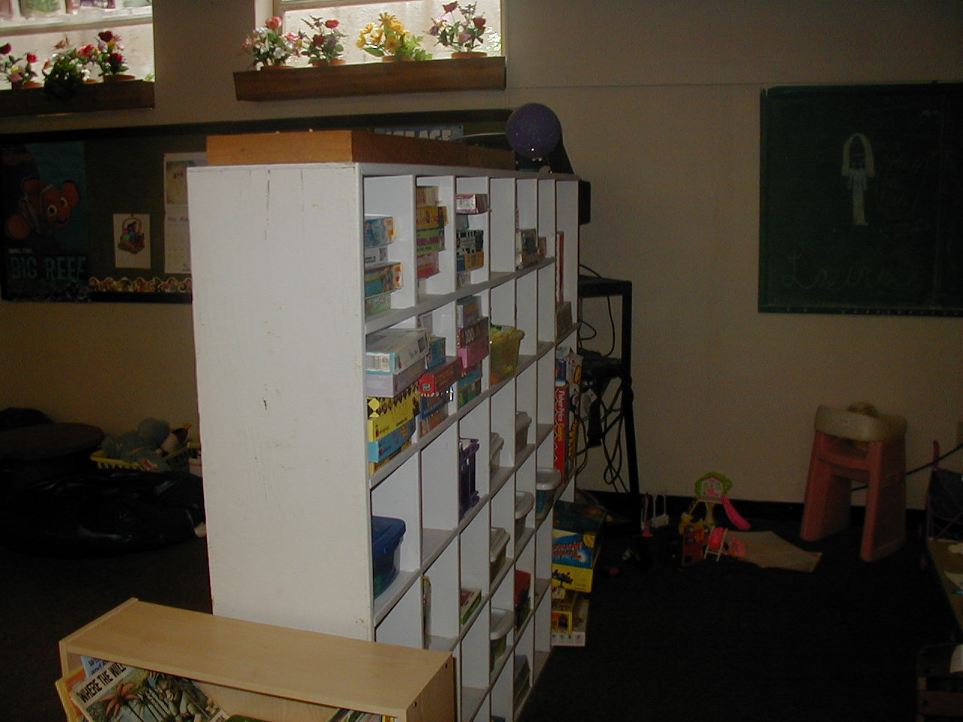

Slide 53
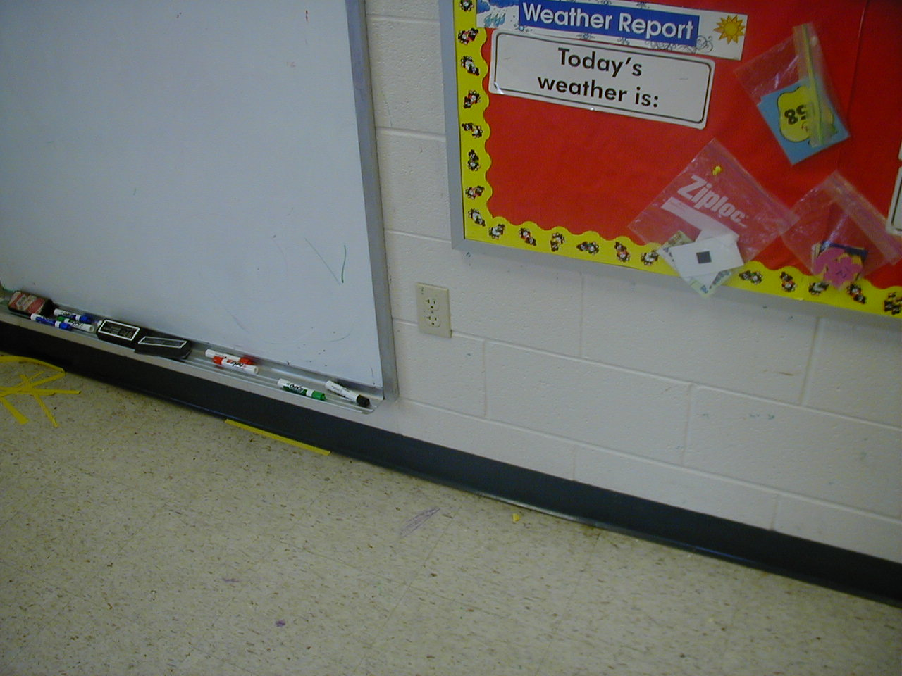

Slide 54
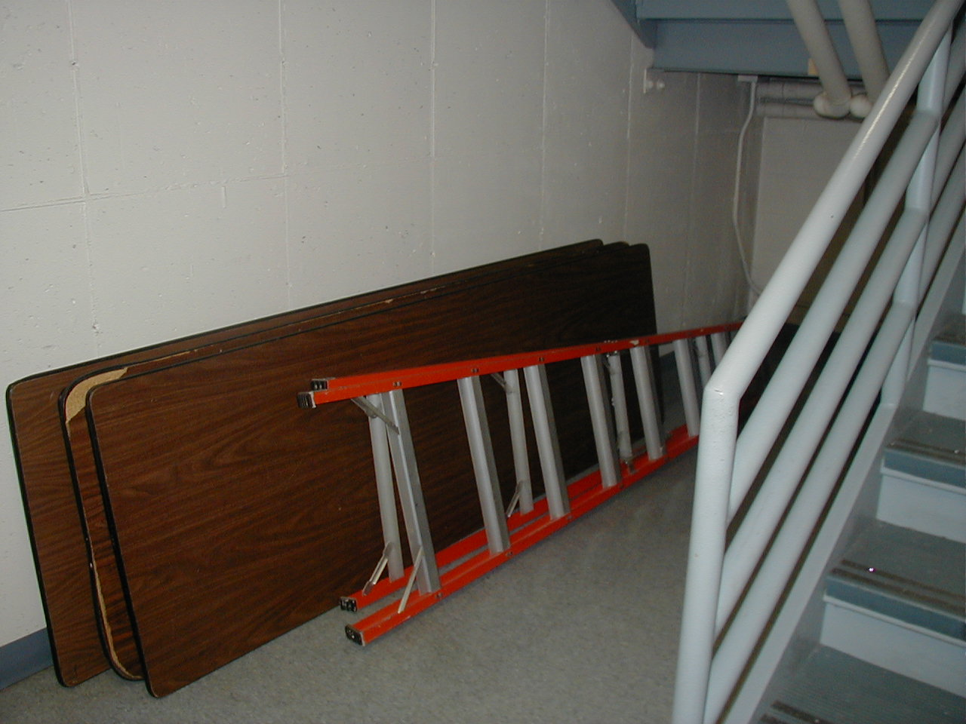

Slide 55
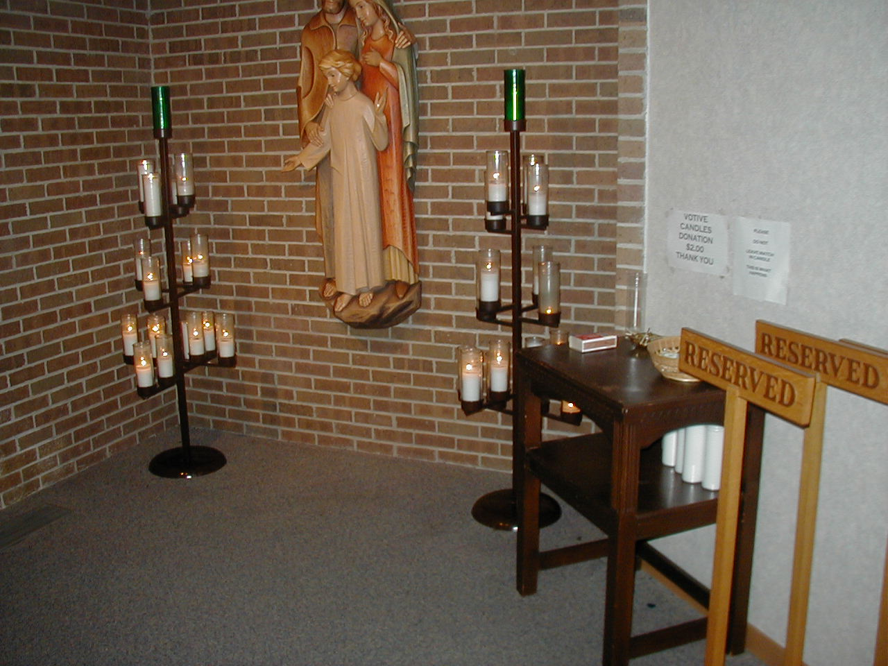

Slide 56
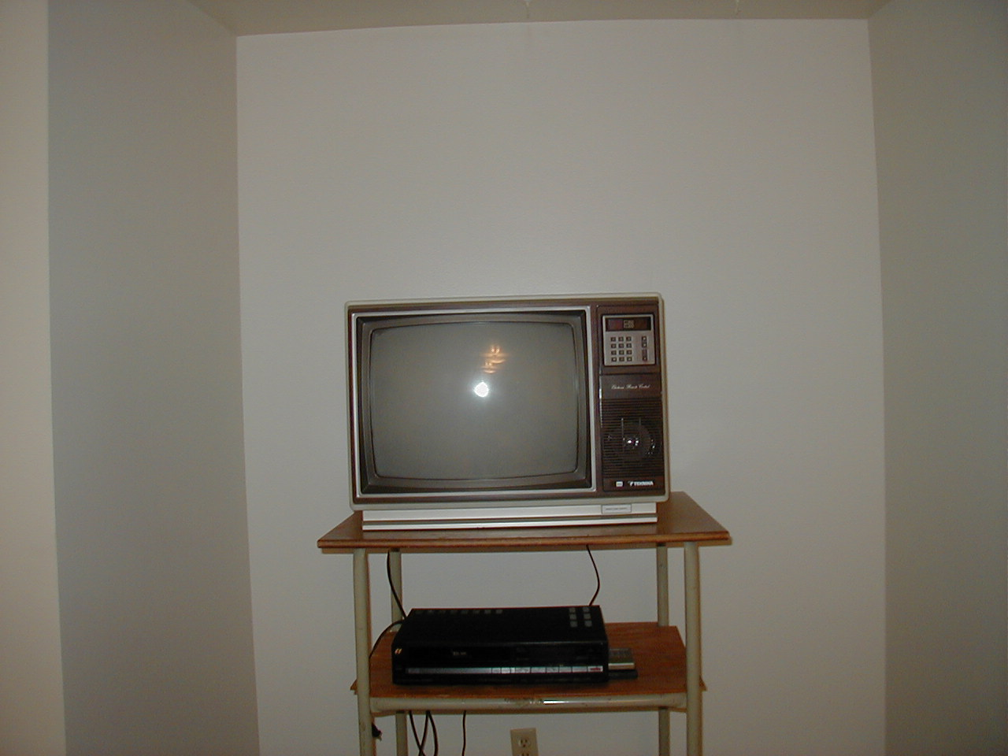

Slide 57
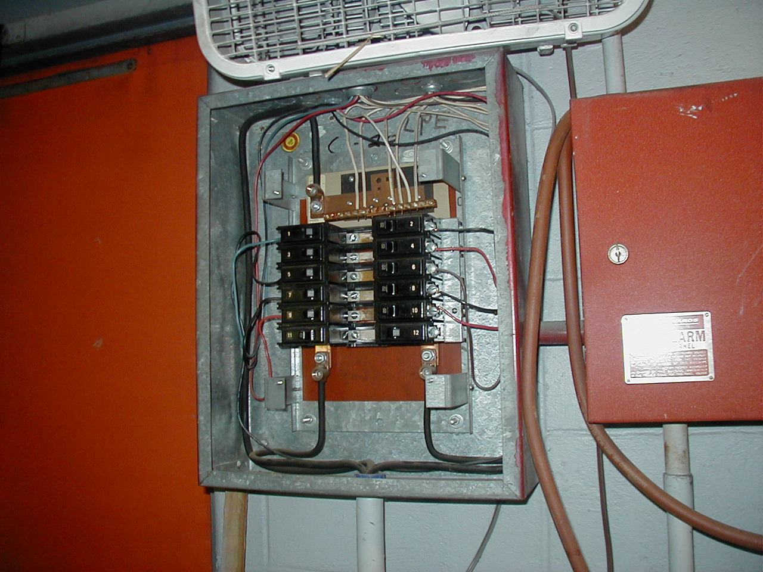
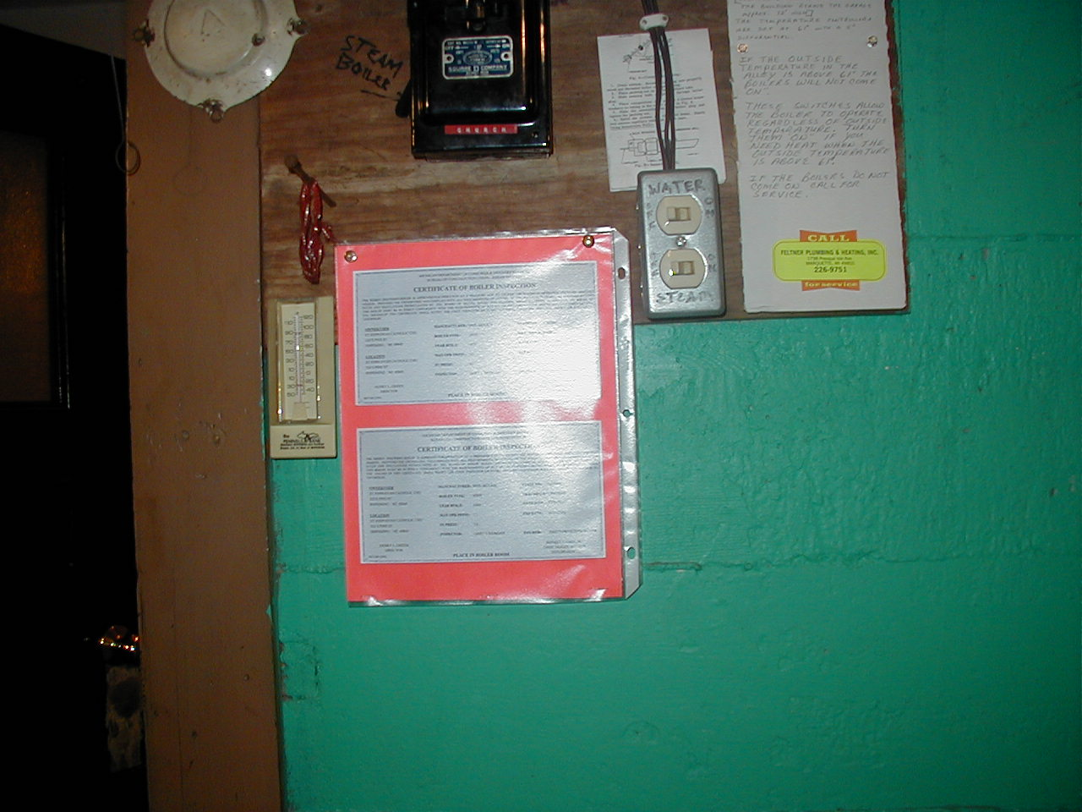

Slide 58
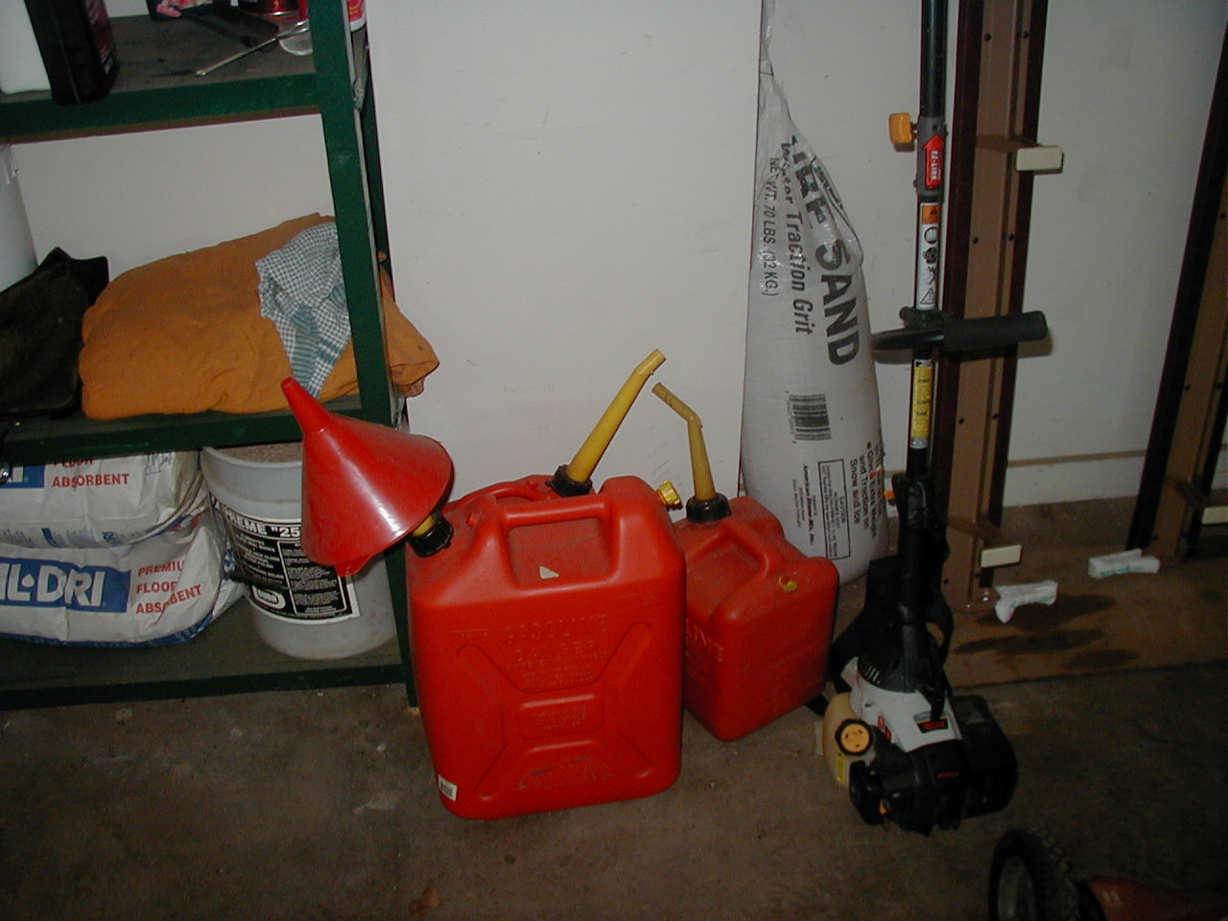

Slide 59
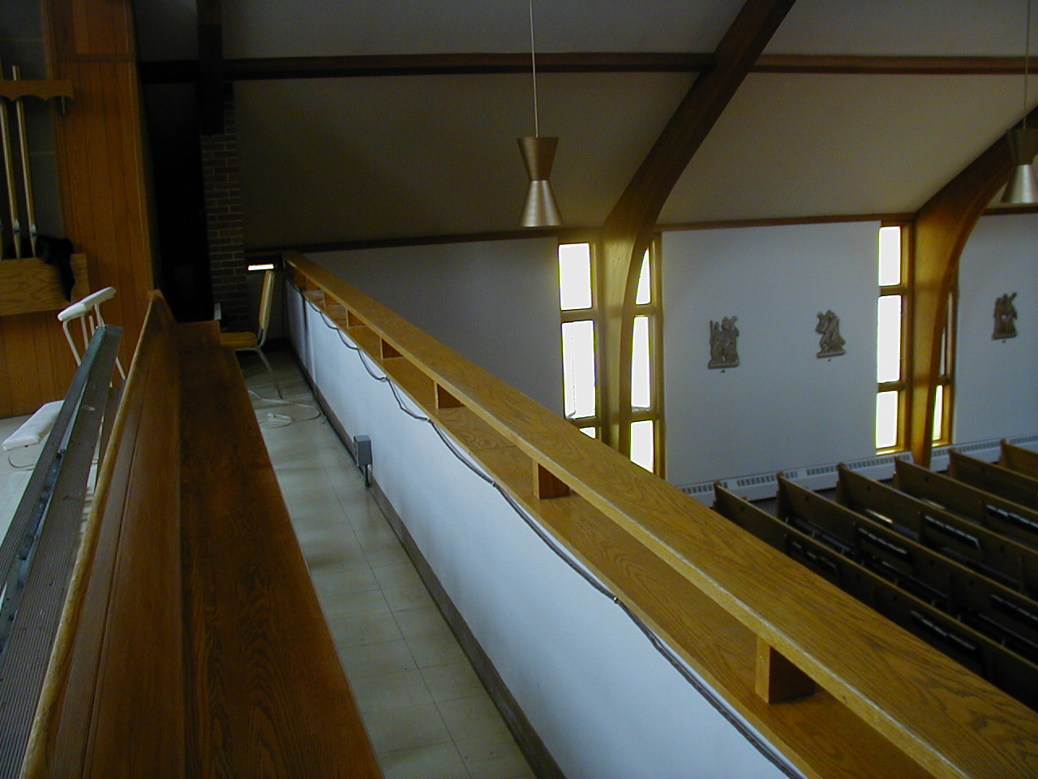
Notes:
42”

Slide 60
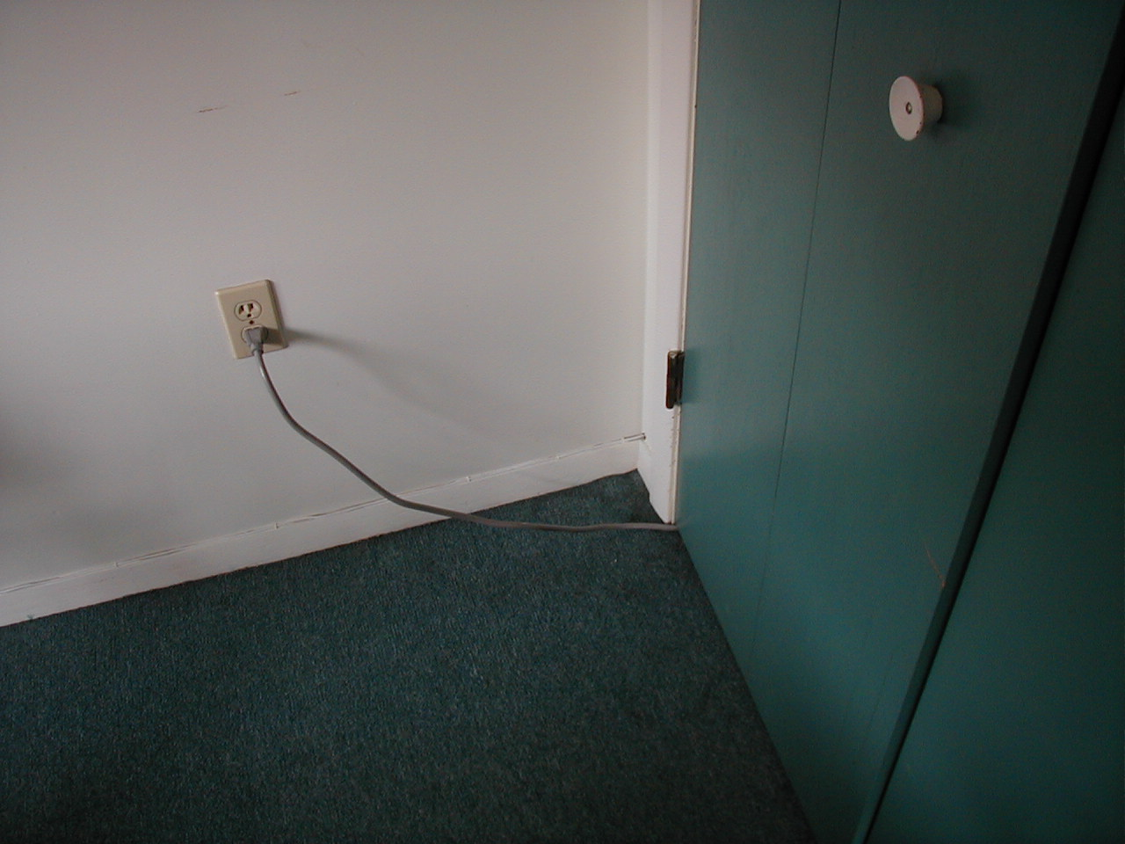

Slide 61
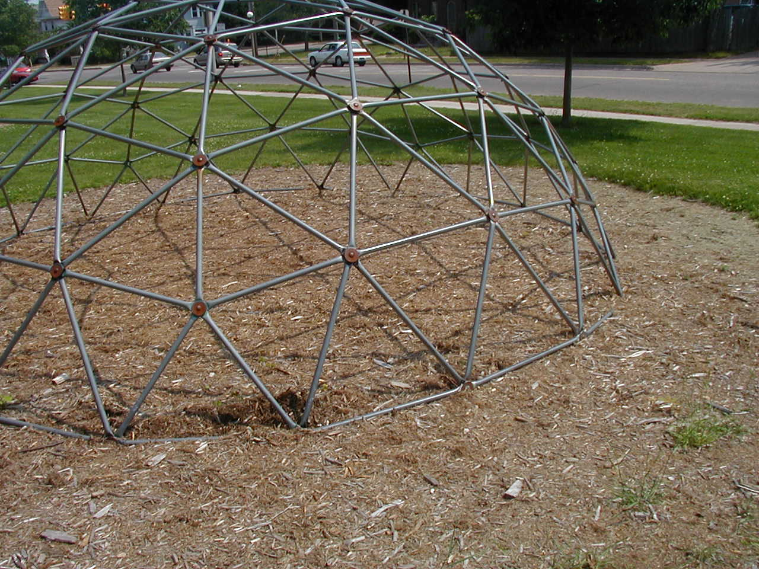

Slide 62
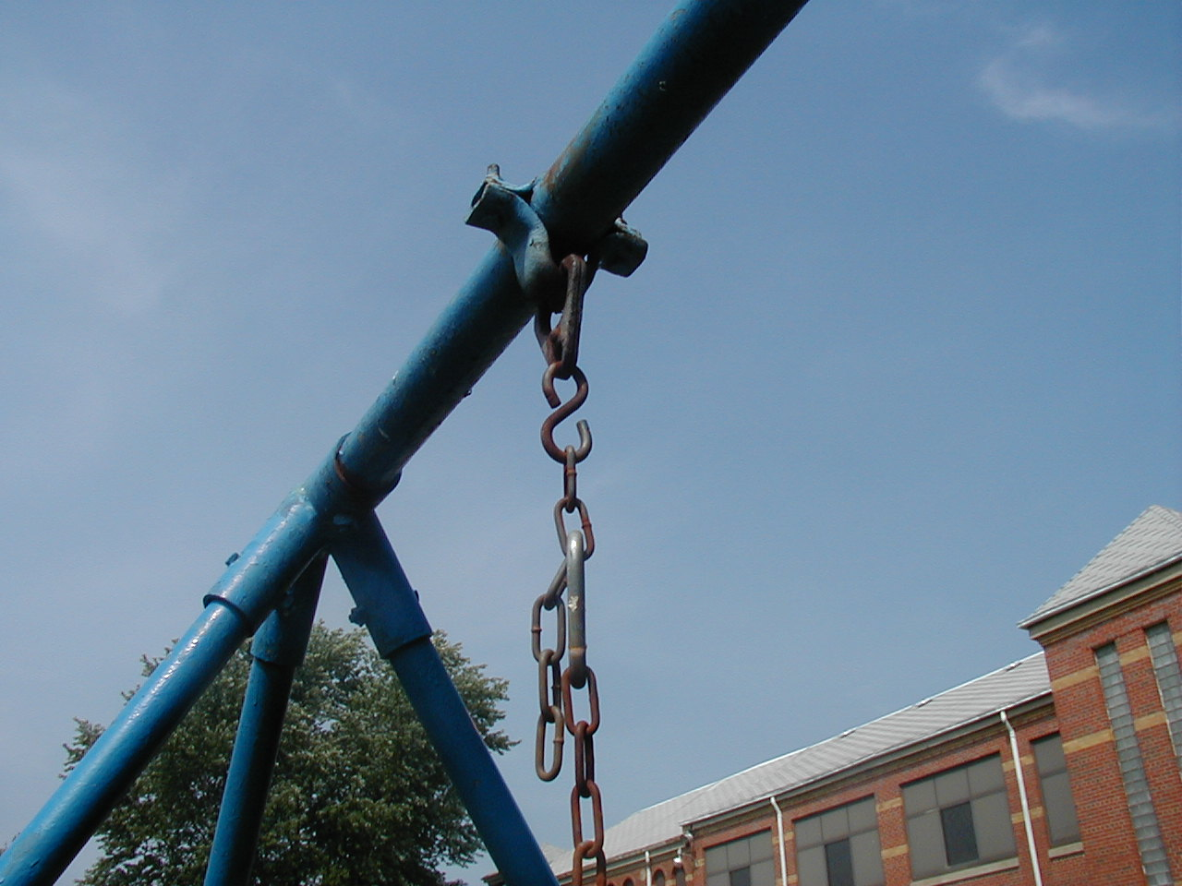

Slide 63
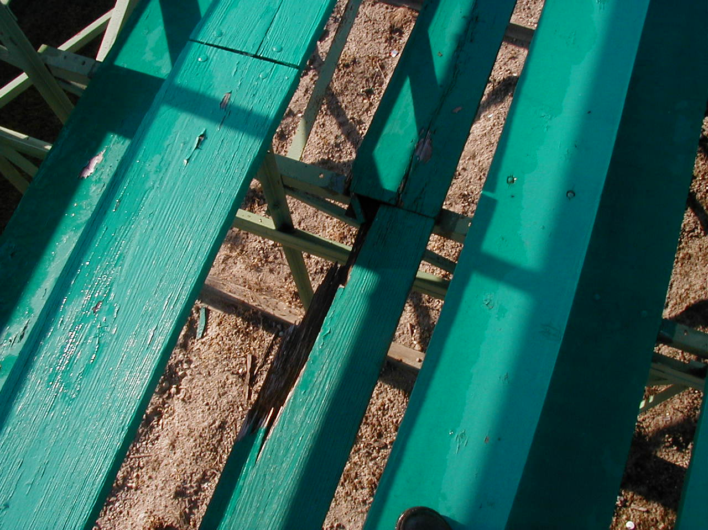

Slide 64
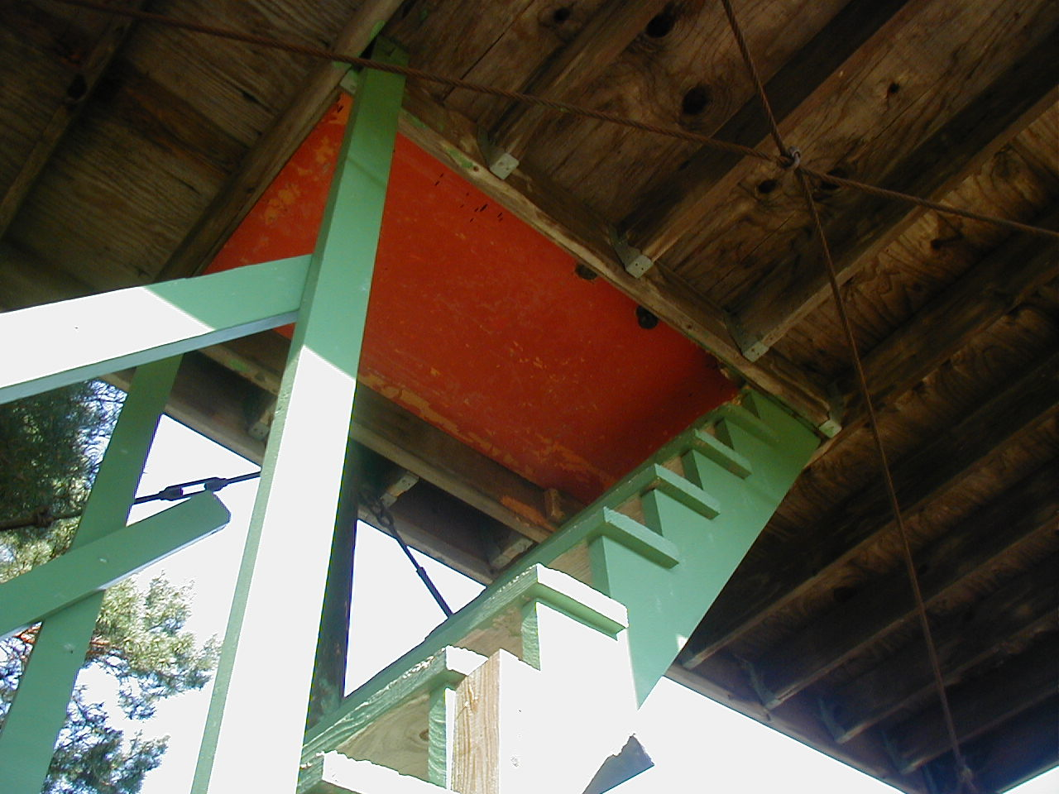

Slide 65
Lessons from the Field
Most Frequently Used Recommendations
Repeat Offenders
How Underwriters use the data
Major topic of concern
Fraud Prevention
How we can help

Slide 66
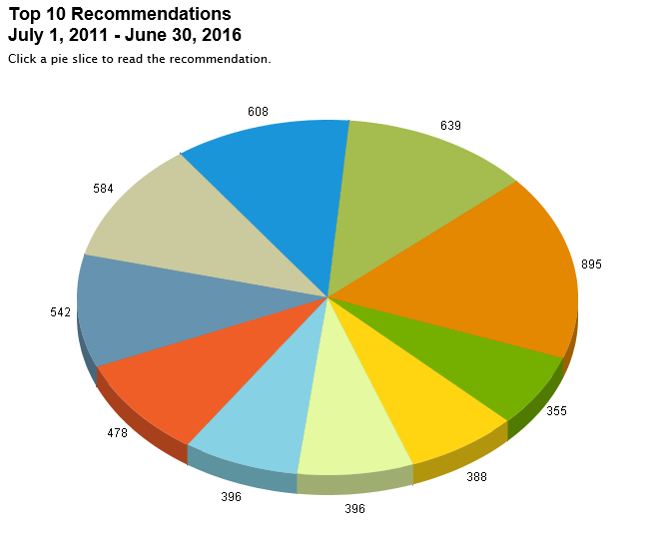
Lessons from the Field Top 10 Recommendations

Slide 67
Top 10 Recommendations
Non-GFCI Outlets
Emergency Lighting Repair
Video Inventory
Self-inspections
Operation Identification
Fire Extinguisher Service
Emergency Exit Signs
Accounting Practices
Outside Persons Liability Insurance
Electrical Panel Access

Slide 68
Lessons from the Field
Accounting Practices
Lower Frequency of recommendation and occurrence
Potential for major loss
Video to help prevent fraud
Video

Slide 69
LUNCH

Slide 70
Emerging Issues
Age of Buildings
Travelers’ Roof maintenance and inspection checklist
Lead in Water
Statewide School Drinking Water Quality Program
$950 Reimbursement
Expenses incurred 7/1/16 – 9/30/17
Slip, Trip and Fall Control
Snow Log
Travelers’ STF checklist and control document
Special Events
Do’s and Don’ts
Scenarios – You be the judge
Notes:
Should something test positive for lead: isolate it and remove it from service
Schools: Flush out the lines, even in summer

Slide 71
Special Events Do’s and Don’ts
DO use parish funds/check to pay for Special Events
DO make sure ALL information is filled out on the forms, this includes: Unit Number, signature, date, whether or not alcohol is being served.
DO make sure entire triplicate form and check is sent to MCC
DO NOT send the form home with individual
DO verify if the event requires Special Event Insurance or not. When in doubt – fill it out.

Slide 72
Special Events Scenarios
A woman calls and wants to have a wedding reception in your parish hall? (but no alcohol is being served)?
A parishioner stops in and asks if they can use your hall for a fundraiser benefitting their pet poodle’s mounting veterinarian bills?
Pastoral Council President wants to change meeting rooms from basement hall to the newly renovated all-purpose room on the ground floor?
A parishioner calls and is planning a large anniversary party for their parents and wishes to use your gym?
A coworker wants to throw together a bridal shower for another colleague in the employee lounge? What if no alcohol is being served?
The parish is about to host its first annual spring festival with a beer tent, kid’s games and catered food?
Father wants the parish to start hosting monthly AA meetings in the parish hall?
The parish/school staff decides to hold their annual Christmas dinner on-site instead of going out?

Slide 73
BREAK

Slide 74
Online Resources
Learning Management System (LMS)
MCC Risk Management
Travelers’ Risk Control
GB Risk Control

Slide 75
Online Resources Learning Management System
Accessible from MCC website
Individual sign-ons
Tracking ability
List of available modules

Slide 76
List of Available Modules
Basic Evacuation Planning & Procedures
Bloodborne Pathogens for Schools
Catholic Cemeteries Self Inspection/Hazard Recognition
Continuity of Operations Planning
Disaster Planning 101
Determining the Root Cause of Accidents
Electrical Safety
Employee & Family Disaster Planning (Business Continuity Begins at Home)
Fire Prevention Practices
Fraud Prevention (MCC)
Hazard Communication
Housekeeping – Safe Housekeeping Practices Means of Egress
Playground Safety Inspection
Portable Fire Extinguishers I
Portable Fire Extinguishers II
Preventing Injuries When Lifting, Moving and Transferring Residents
Preventing Slips, Trips and Falls
School Hazard Identification
Violence Prevention

Slide 77
Online Resources
MCC Risk Management
http://www.micatholic.org/risk-management/
Link to LMS
New Construction Log
Information & Forms

Slide 78
Online Resources
Travelers Risk Control
https://www.travelers.com/risk-control
Various Toolkits
Do-it-yourself assessments
Email our Loss Control Representative for access
Dawn Safine
Dsafine@travelers.com

Slide 79
Online Resources
GB Risk Control
www.gbriskcontrol.com
Loss Prevention Reports
User ID: DIO####
P/W: DIOCESE
Notes:
Log in as Lansing Catholic 5091 LP Report: 7/25/2011

Slide 80
QUESTIONS

Slide 81
THANK YOU AND BE SAFE!
Michigan Catholic Conference
1-800-395-5565
Vince Andrews, Manager
vandrews@micatholic.org
General questions
riskmanagement@micatholic.org
John D. Greenburg
jgreenburg@micatholic.org

